Slide 1
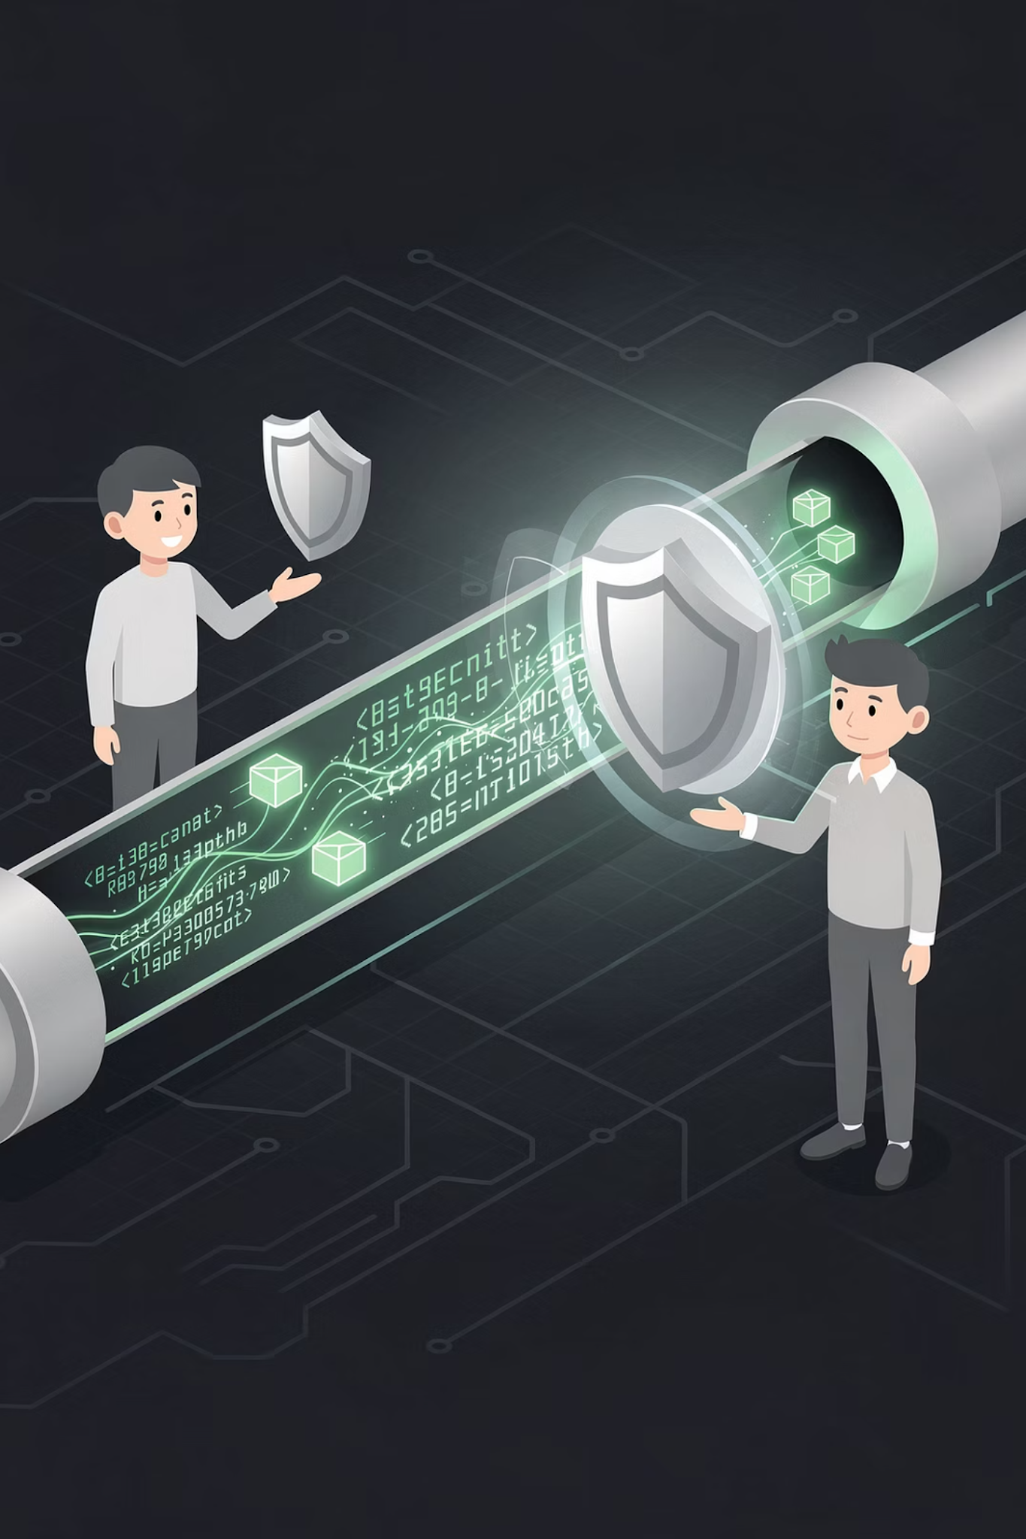

Foundations on DevSecOps, DevOps Failures & Cost Awareness
Building Secure, Reliable & Cost-Efficient Systems
1

Slide 2
Session Agenda
01
02
What is DevSecOps?
Security as Code & Shift Left
03
04
DevOps Failures
Cost Awareness in Cloud
Technical + Cultural
05
06
Real-World Examples
Diagrams & Discussion
2

Slide 3


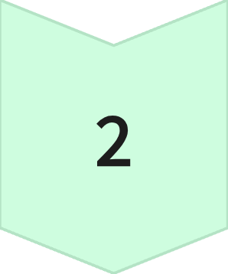
PART 1 — DEVSECOPS
What is DevSecOps?
DevSecOps = Development + Security + Operations
Old Way
Dev → Ops → Security at end
DevSecOps
Dev + Sec + Ops together
3

Slide 4
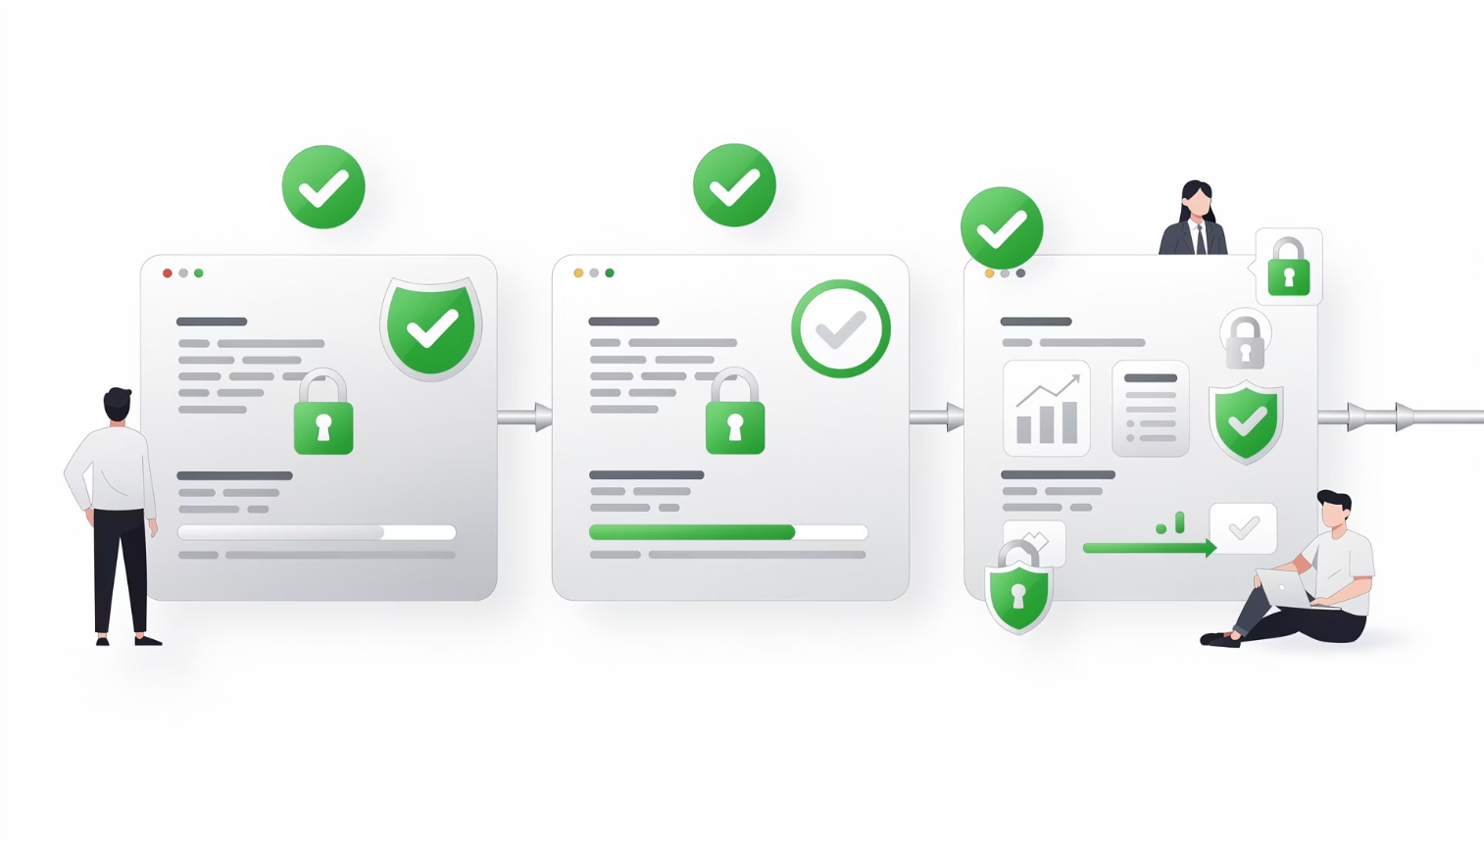
PART 1 — DEVSECOPS
Security as Code Mindset
Security becomes part of the pipeline — not a manual checklist.
Automated
Version-Controlled
Tested
CI/CD Integrated
Example:
Automated security scans
Infrastructure security rules in code
Policy enforcement via configuration
4

Slide 5
PART 1 — DEVSECOPS
Shift Left Concept
Traditional security waits until the end — DevSecOps starts at the very beginning.
SLDC FLOW
Plan
Build
Deploy
Threat modeling and requirement security
Dependency scanning and artifact hardening
Configuration audits and policy gates
Code
Test
Monitor
Static analysis and secure coding reviews
Dynamic tests and penetration checks
Runtime protection and continuous feedback
Key Idea:
Fixing security early is cheaper and safer.
5

Slide 6
PART 1 — DEVSECOPS
Traditional Security vs DevSecOps
Traditional
DevSecOps
Security at end
Manual review
Slow approvals
Separate teams
Security integrated
Automated scans
Continuous validation
Shared responsibility
Security becomes continuous — not a gate at the end.
6

Slide 7
PART 1 — DEVSECOPS
DevSecOps Maturity Levels
Level 1 – Basic DevOps
1
CI/CD implemented, minimal security automation
Level 2 – Integrated Security
2
Code scanning, image scanning, access policies
Level 3 – Mature DevSecOps
3
Automated policy enforcement, continuous compliance, real-time threat detection
Security maturity grows over time — it's a journey, not a switch.
7

Slide 8
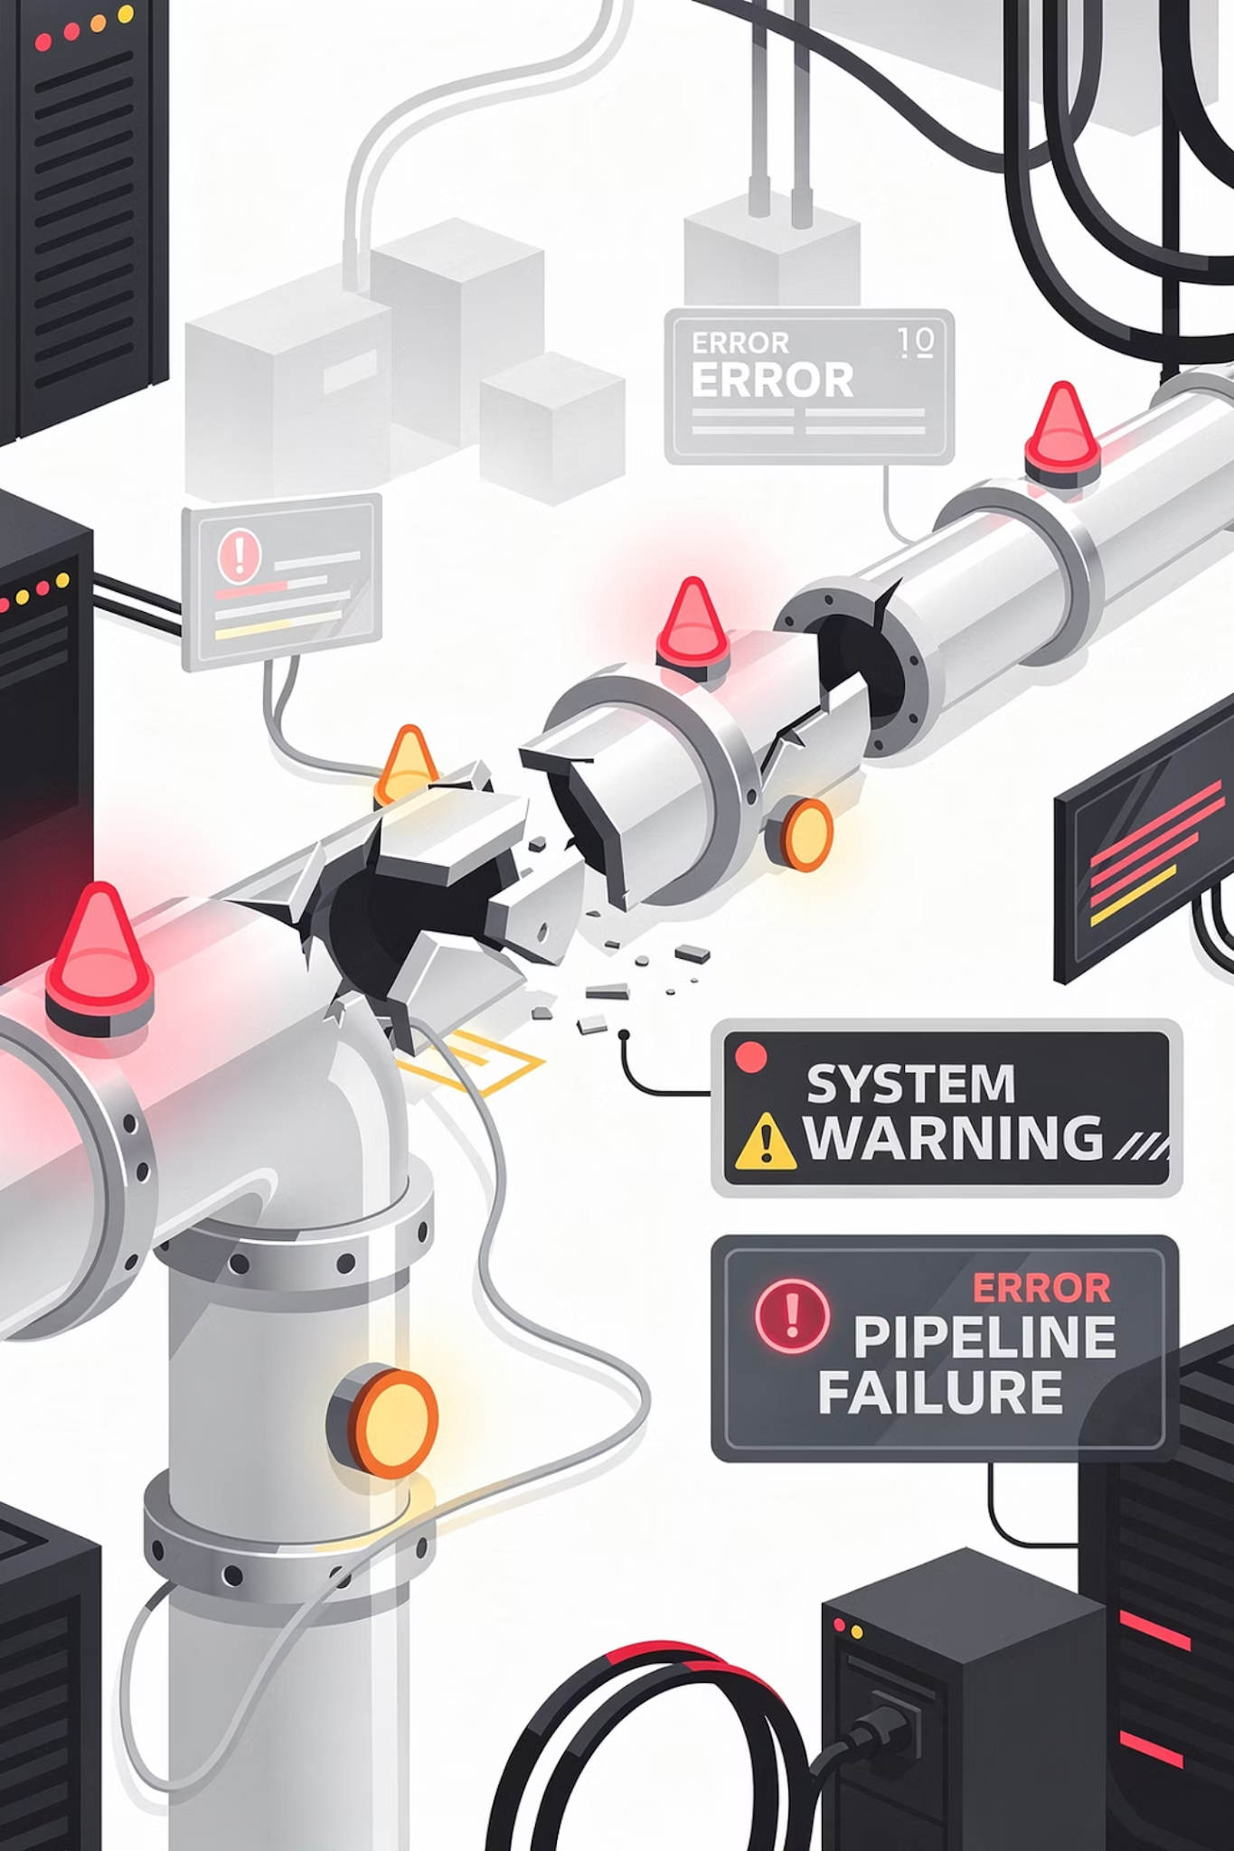
PART 2 — DEVOPS FAILURES
What is DevOps Failure?
Automation Breaks
Weak Processes
Communication Fails
No Monitoring
DevOps is not only tools — it's culture + process + automation.
8

Slide 9


PART 2 — DEVOPS FAILURES
Cultural vs Technical Failures
Technical Failures
No testing
Broken CI/CD
Poor monitoring
Cultural Failures
Blame culture
No collaboration
Lack of ownership
No documentation
Most failures are cultural, not technical.
9

Slide 10
PART 2 — DEVOPS FAILURES
Misalignment Between Teams
Dev
Security
Ops
Optimizes for speed
Optimizes for safety
Optimizes for stability
Without alignment → conflict. Three teams pulling in different directions creates friction, delays, and failures.
10

Slide 11
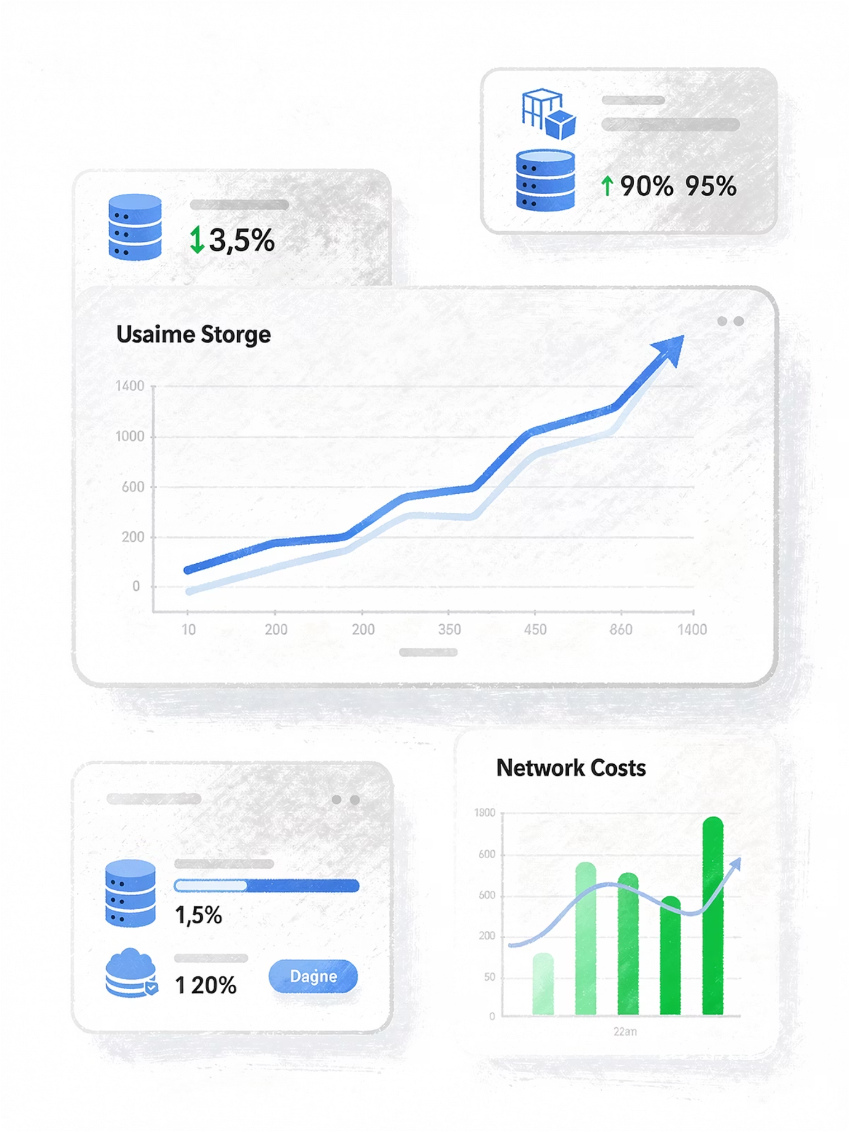




PART 3 — COST AWARENESS
Why Cost Awareness Matters
Cloud = Pay-as-you-use.
More usage → higher bill. DevOps engineers must balance all four dimensions:
Performance
Security
Reliability
Cost
11

Slide 12
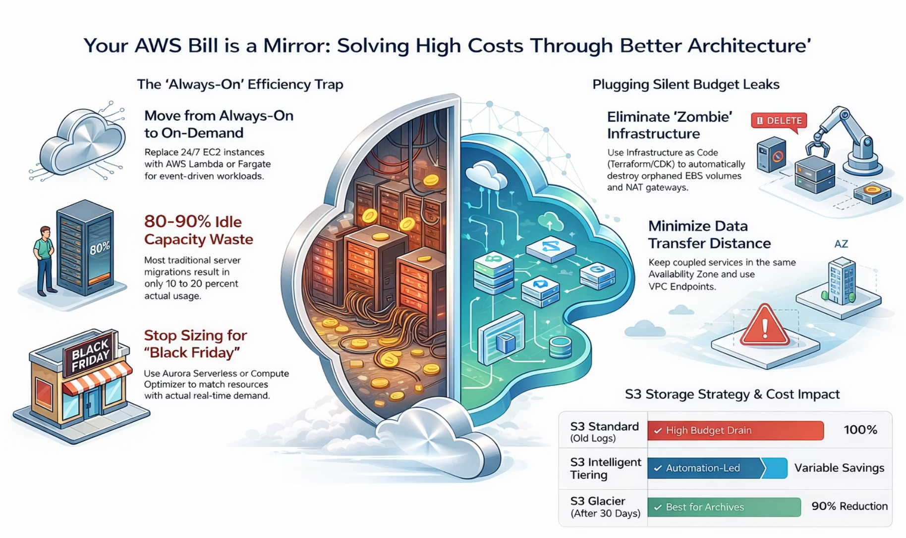

PART 3 — COST AWARENESS
Poor Architecture = High Bills
Oversized Servers
Large instances for small workloads
No Auto-Scaling
Fixed capacity regardless of demand
Always-On Test Envs
Never shut down after use
Insufficient Storage
Unused data accumulating costs
12

Slide 13

PART 3 — COST AWARENESS
DevOps Engineers Must Think Financially
1
2
Right-size instances
Auto-scale
Do we really need this instance size?
Can we scale up and down automatically?
3
4
Schedule shutdowns
Optimize storage
Can we turn off environments at night?
Are we storing only what we need?
Technical decisions = Financial impact.
13

Slide 14
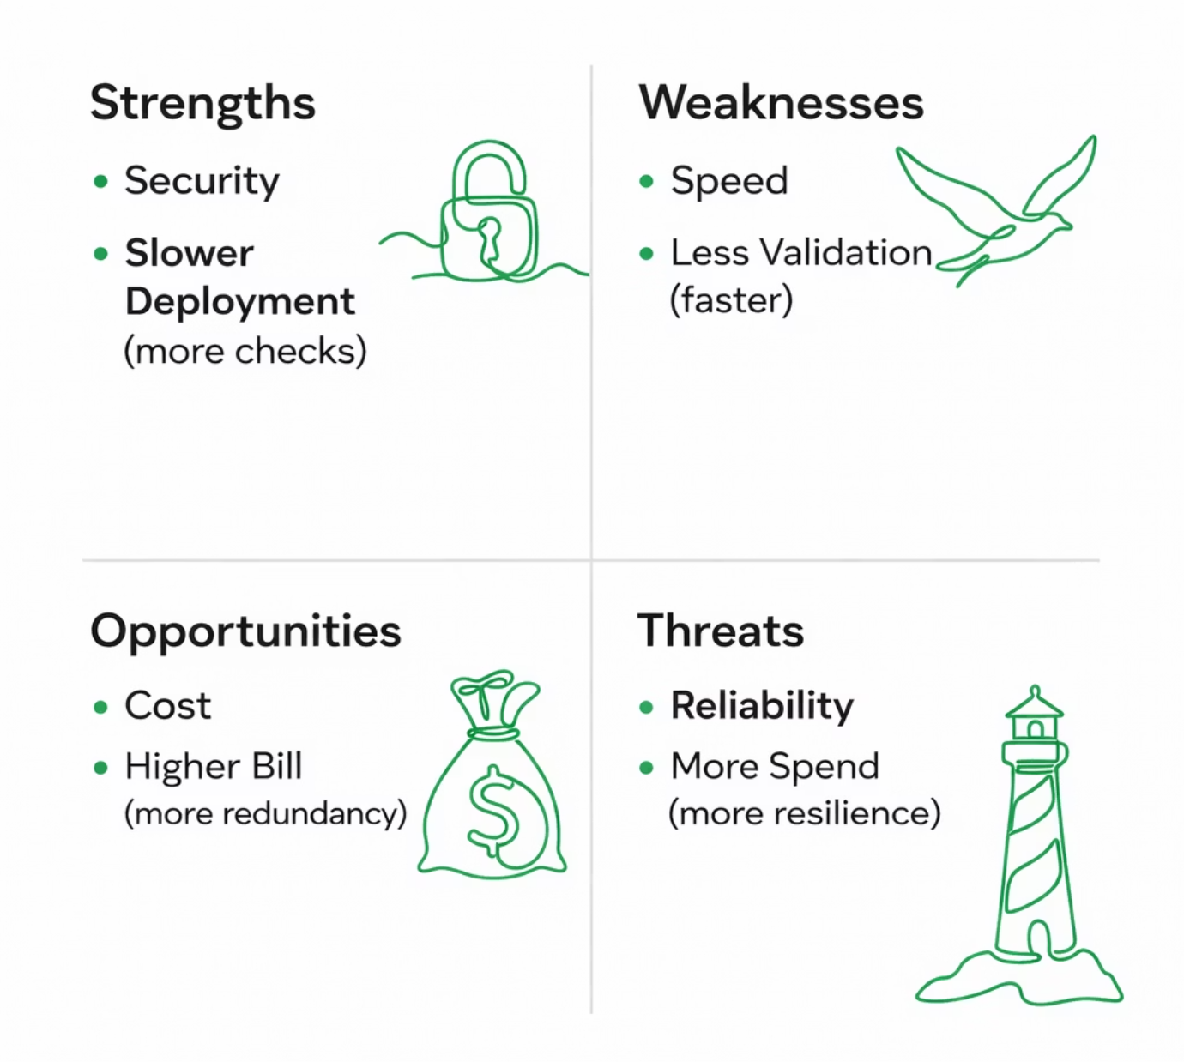
PART 3 — COST AWARENESS
Risk-Based Decision Making
Every DevOps decision balances four competing forces:
More security checks → slower deployment
More redundancy → higher cost
Faster releases → higher risk
DevOps engineers must balance trade-offs deliberately.
14

Slide 15

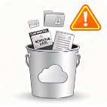

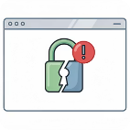
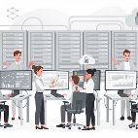
REAL-WORLD EXAMPLES — DEVSECOPS
Security Failures in the Wild
Exposed Storage Bucket
Hardcoded Passwords
Publicly accessible bucket.
Credentials in source code.
Risk:
Risk:
Sensitive data leaked
Legal consequences
Reputation damage
Credential leaks
Repository exposure
Better:
Lesson:
Use secret management tools.
Proper access control + automated checks.
Missing SSL Certificates
Security at Scale
Website running on HTTP instead of HTTPS.
Companies like Amazon Google
Risk:
Use:
Data interception
Browser warnings
Trust issues
Automated security scanning
Infrastructure validation
Continuous monitoring
Lesson:
Security at scale requires automation.
Always enforce HTTPS.
15

Slide 16
REAL-WORLD EXAMPLES — DEVOPS FAILURES
DevOps Failure Patterns
Deploy Without Testing (Testing is not optional.)
No Monitoring
System fails silently.
Code → Deploy → Production outage.
No alerts, no dashboard. Problem discovered by customers.
Result : Users impacted, revenue lost, emergency fixes required.
Late detection = larger damage.
No Rollback Strategy
Over-Automation
New deployment breaks production with no rollback plan.
Automation without validation can:
Deploy broken configs, delete resources, or propagate errors fast. Always include safeguards.
Result : Long downtime. Rollback strategy is critical.
16

Slide 17
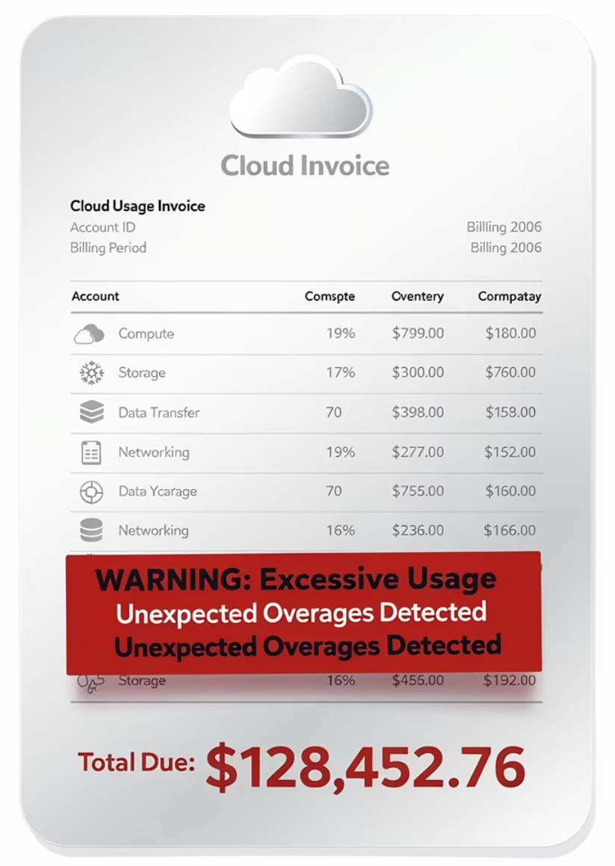
REAL-WORLD EXAMPLES — COST MISTAKES
Common Cloud Cost Mistakes
Large Servers 24/7
Unused Environments
High-capacity server running at 5% usage all night.
Test environments never shut down
Result: Monthly bill increases silently.
Fix: auto-scale or schedule shutdown.
No Auto-Scaling
Over-Provisioning
Traffic drops at night but infrastructure stays the same size. Pure waste.
"Just in case" fear-based allocation
Result: Underutilized, expensive infrastructure.
17

Slide 18
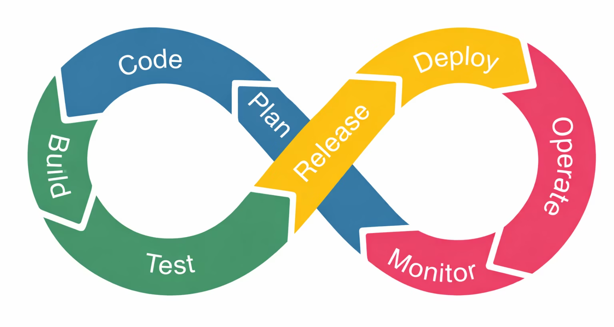
DevSecOps Lifecycle
Security is embedded at every stage — from planning to monitoring. Security everywhere means no blind spots in the pipeline.
18

Slide 19
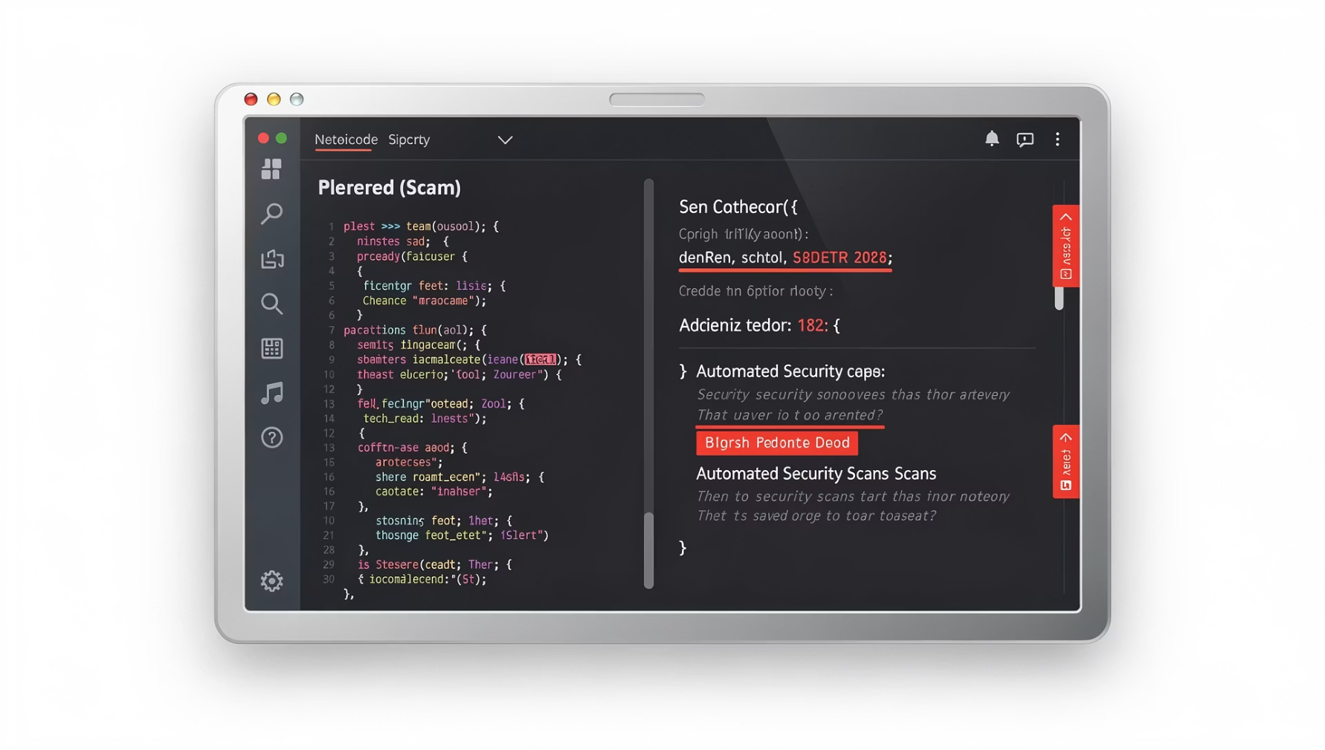
Static Code Scanning
Purpose
Automatically detects vulnerabilities in code before deployment.
What It Catches
SQL injection risks
Hardcoded credentials
Unsafe functions
Integrated directly into the CI pipeline — no manual review needed.
19

Slide 20
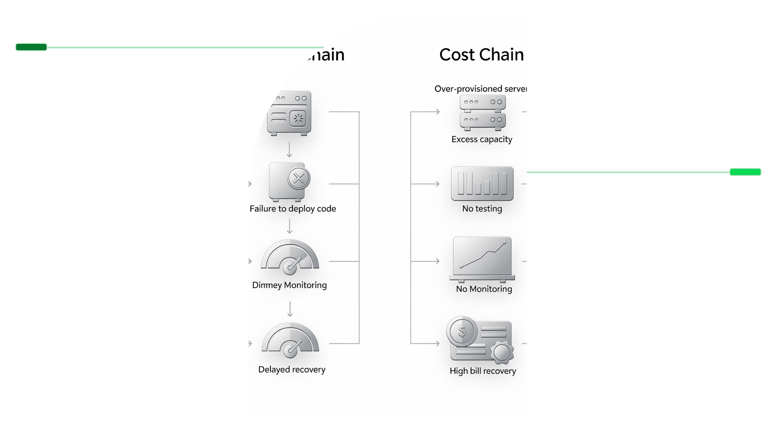
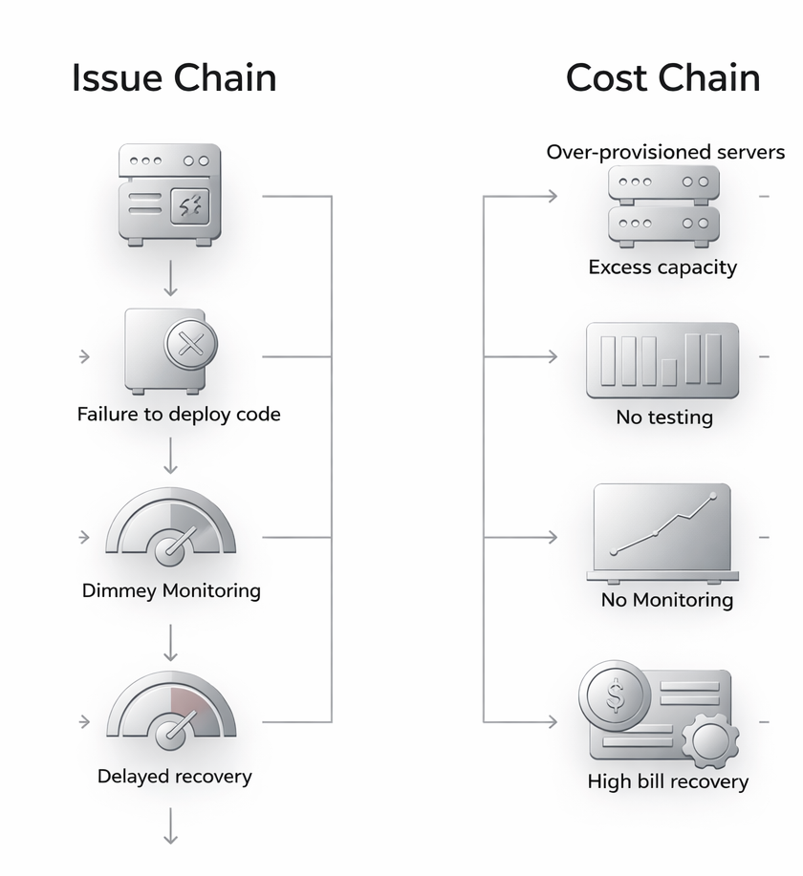
Failure & Cost Flow
Failure Flow
Code → Deploy → No Testing → Crash → No Monitoring → Late Recovery
Cost Flow
Over‑Provisioned Server → Low Usage → High Monthly Bill
Each missing layer in the failure chain increases risk. Fixed infrastructure vs. auto-scaled infrastructure is the difference between waste and efficiency.
20

Slide 21
DISCUSSION
Critical Thinking Questions
Security Thinking
Failure Thinking
Cost Thinking
Where should security checks be added?
What happens if security is added only at the end?
Who owns security in DevOps?
If deployment fails at midnight, what must exist? (Monitoring, alerting, on-call, rollback)
What is a rollback strategy? Revert to last stable version quickly.
Traffic drops at night → auto-scale down
Should DevOps monitor billing dashboards? → Yes
Who owns cost optimization? → Everyone (shared responsibility)
21

Slide 22
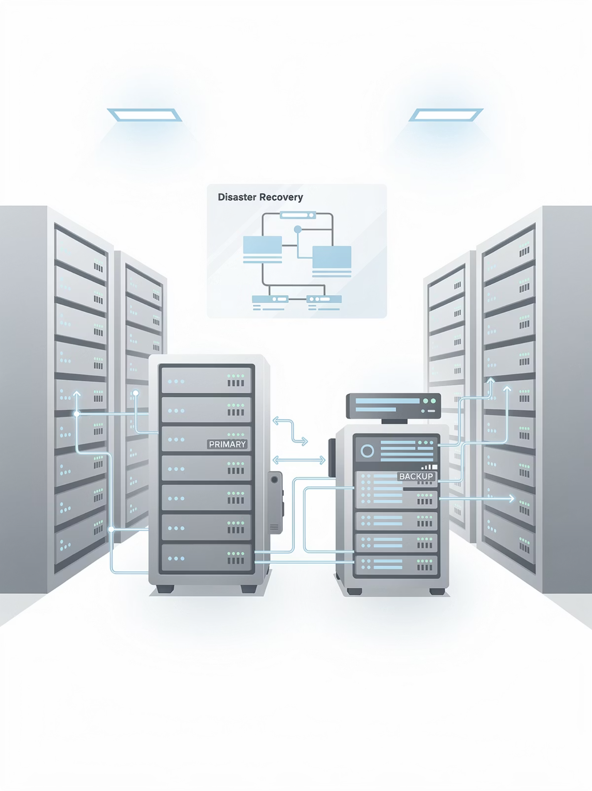




Disaster Recovery (DR) Awareness
Disaster Recovery is the strategy and process to restore systems after a major failure.
Data Center Outage
Cloud Region Failure
Ransomware Attack
Accidental Data Deletion
22

Slide 23
The Final DevOps Mindset
Before deploying
1
Is it tested?
2
Before exposing
Is it secure?
Before scaling
3
Is it optimized?
4
Before automating
Is it validated?
Before provisioning
5
Is it cost-efficient?
DevOps = Engineering + Ownership + Responsibility
23

Slide 24
Final Takeaways
DevSecOps
Cost Awareness
Security integrated everywhere — not a final gate, but a continuous practice throughout the pipeline.
Engineering decisions have direct financial impact. Think securely, reliably, and financially.
1
2
3
DevOps Failures
Often cultural and process-related. Blame culture, lack of ownership, and poor communication are the real culprits.
24

Slide 25


Thank You
25

